Slide 1

Monthly inflation analysis :A comprehensive study

Slide 2
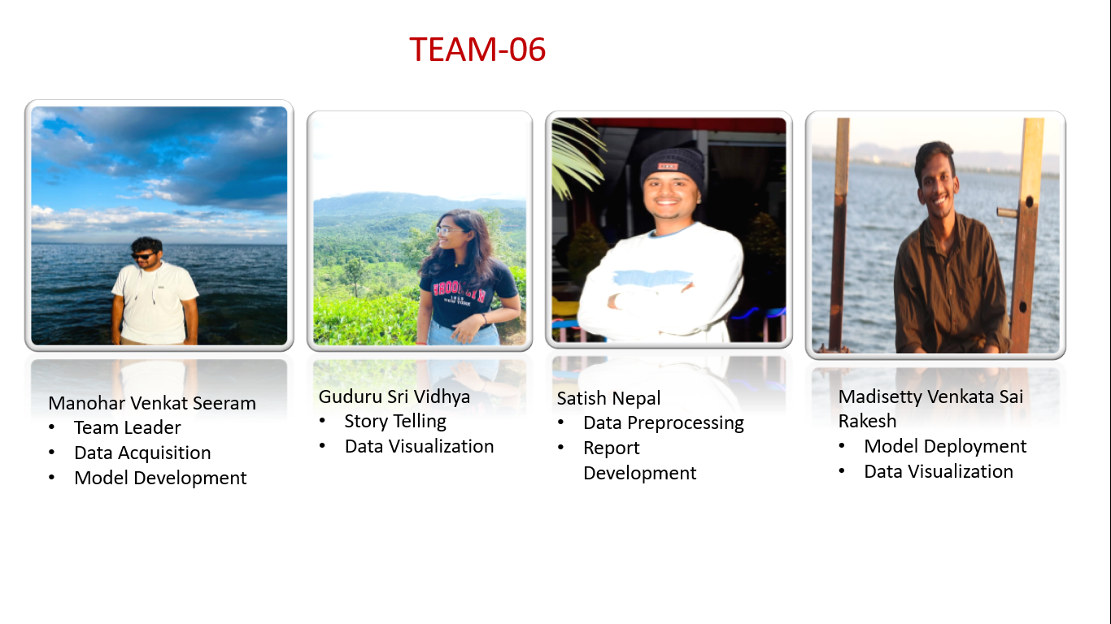

Slide 3
Table of content
Abstract
Challenges
Objectives
Project plan
Dataset
Data pre-processing
Exploratory data analysis(EDA)
Model Deployment
CONCLUSION

Slide 4
Abstract
Food price inflation is an important metric to inform economic policy but traditional sources of consumer prices are too often produced with delay during crisis and only at an aggregate level. This may poorly reflect the actual price trends in rural areas where large populations reside in fragile situation.

Slide 5
Challanges
a
b
c
Supply Chain Disruption
Market Competition
Labour Cost

Slide 6
OBJECTIVE
The Monthly Food Price Inflation Analysis project seeks to examine historical data to discern trends and patterns in food prices, focusing on key drivers like supply and demand dynamics, economic indicators, and external influences. It aims to shed light on regional disparities in food price inflation while evaluating inflation rates for specific commodities within different sectors.

Slide 7
Project Plan
To predict the inflation rate based on the OHLC trends
Data Collection and Preprocessing
Data Modelling
Model Evaluation and Deployment

Slide 8
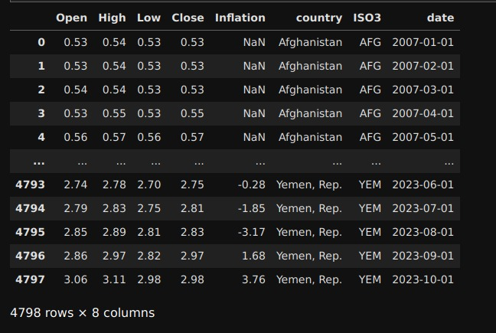
Data Set
Monthly Inflation dataset is taken from Kaggle.
The following challenges were extracted based on this dataset and this project provides valuable insights for decision–makers.

Slide 9
Data Preprocessing
• Handling missing values was the main concern for this dataset as there were several missing values, so we filled the empty values with the mean of the respective column.
• Detection and treatment of outliers to prevent their adverse impact on model performance.
• Creating new features or transforming existing ones to improve model performance, we tried to create a new column called price change from opening and closing price

Slide 10






Training a classification model
Increasing inflation
Train Data
Classification model
Decreasing Inflation
.CSV data
(open, close, Low, High )
Test Data
Preprocessing

Slide 11


Model Deployment
Deployed the application using Flask
Open-source app framework for Machine Learning and Data Science
Deployed Application
GitHub link:-
https://github.com/Team6/DS

Slide 12

Conclusion
In conclusion, this project marks a testament to the power of data-driven decision-making. By meticulously analyzing, modeling, and visualizing our data, we've not only gained profound insights into global inflation but also developed a robust predictive model. Through seamless deployment and continuous monitoring, we've ensured that these insights translate into actionable value for stakeholders.

Slide 13


